Slide 1
Mobile Test Automation Project(CMPE 287)
Team Members:
Venkata Bharadwaj Senapathi (010745605) Priya Shah (010114598) Ann Rose Cyriac (010095267) Nagashree Hiremagalur Suresh (010731942)
Sirichandana Gaddampally (010316865) Apoorva Davu (010027004) Mounika Muga (010763324) Rohith Reddy Vootla (010752014)

Slide 2

Test Object (Mobile Application)
Postmates (Android Version)
Network of couriers providing on-Demand service
delivering goods locally.
Uses Urban Logistics Platform to connect customer
to local courier services delivering anything from
lunch, groceries to office supplies.
Similar to Uber because of its use of mobile phones
to receive orders and dispatch delivery drivers.
Supports business categories that rely on mobile
applications and GPS to match consumer demands.

Slide 3
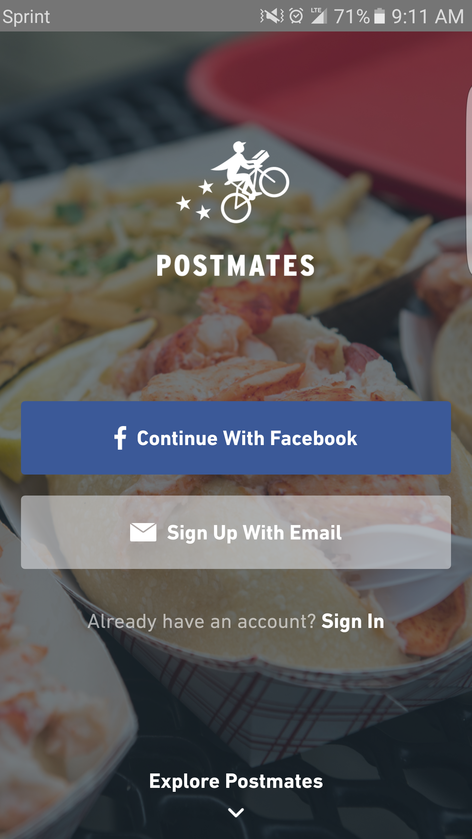
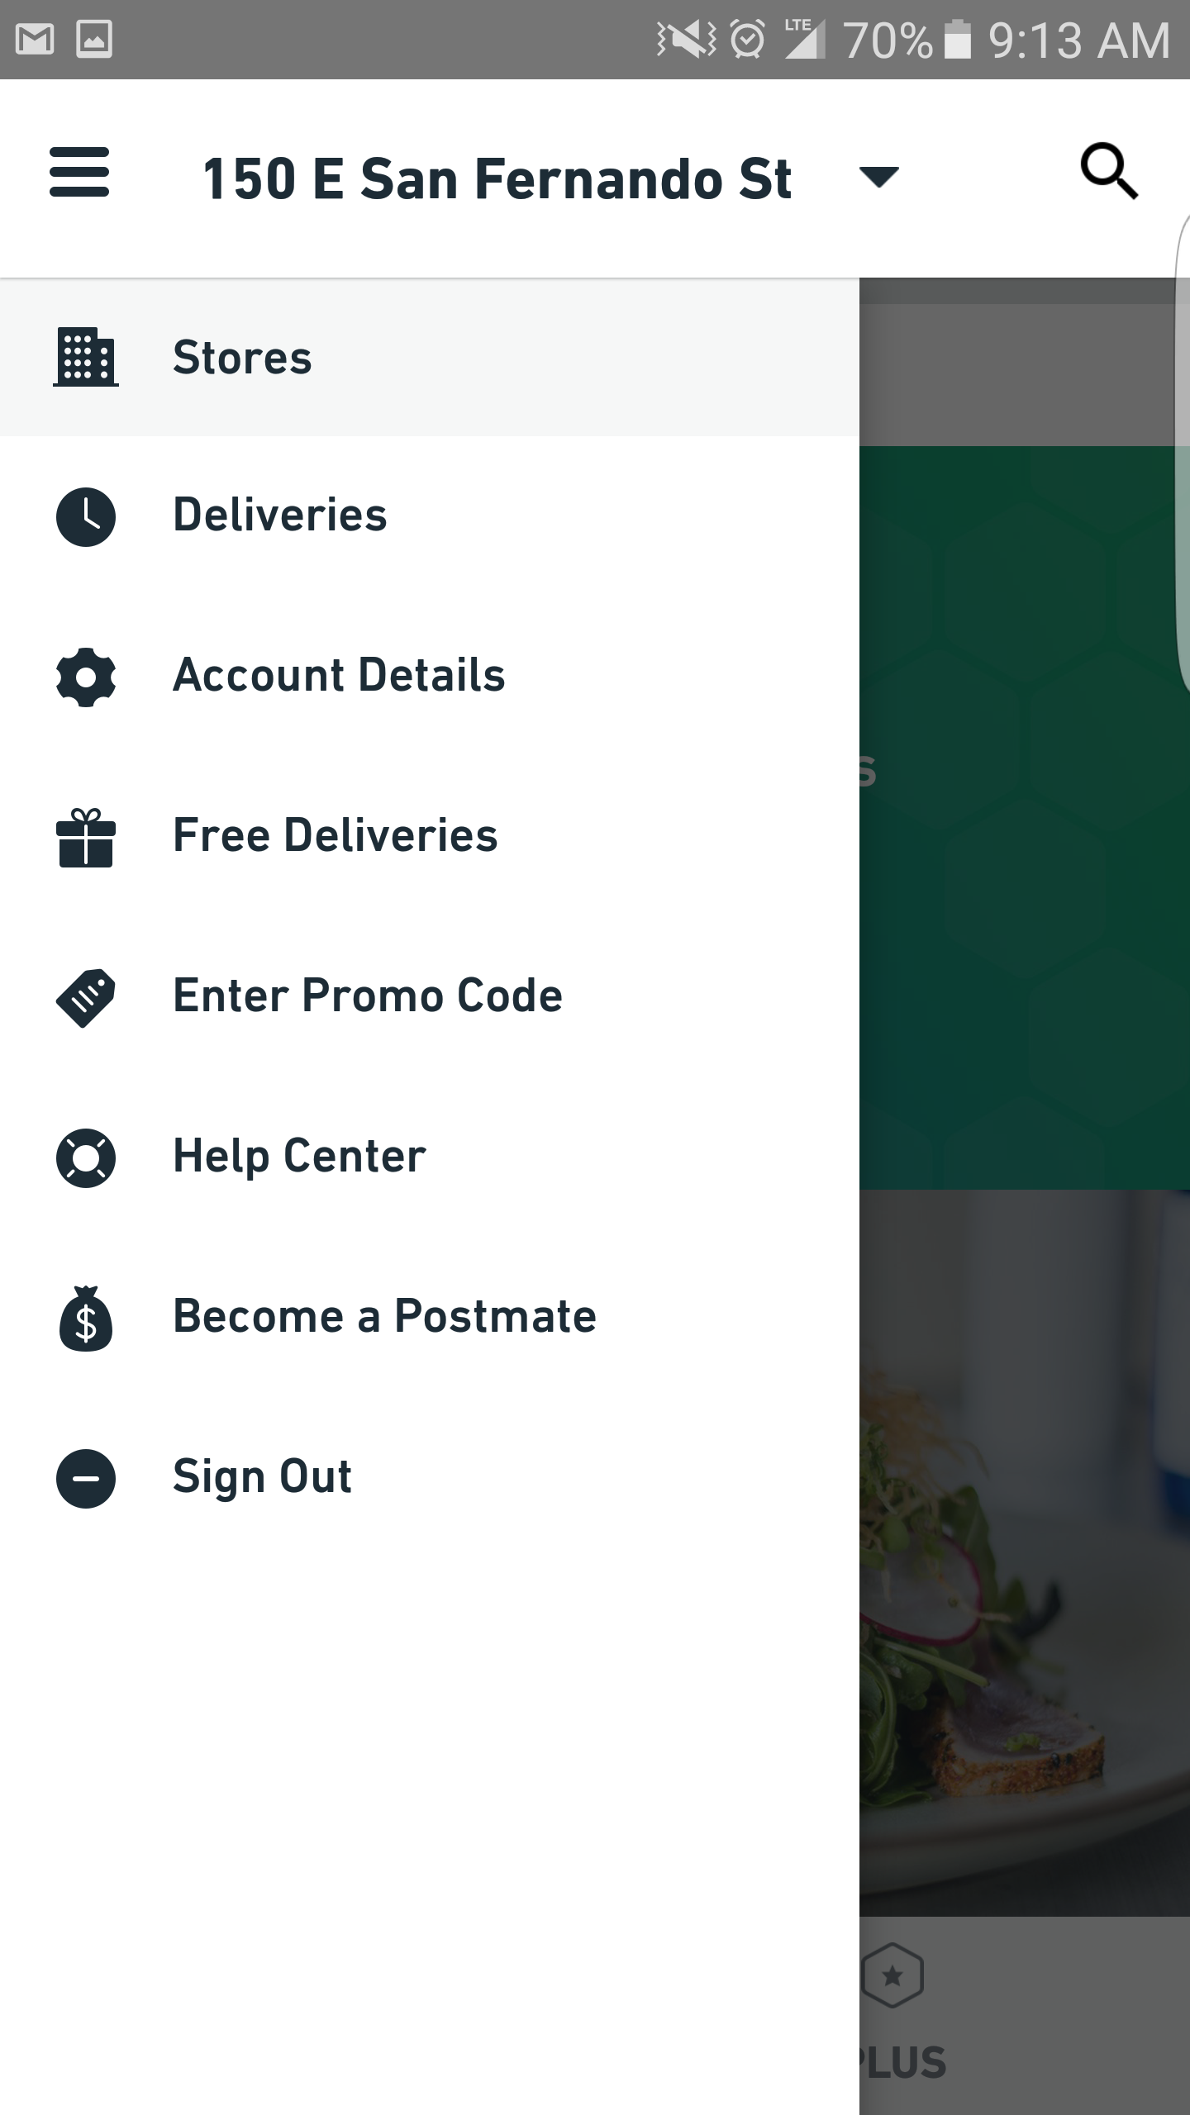
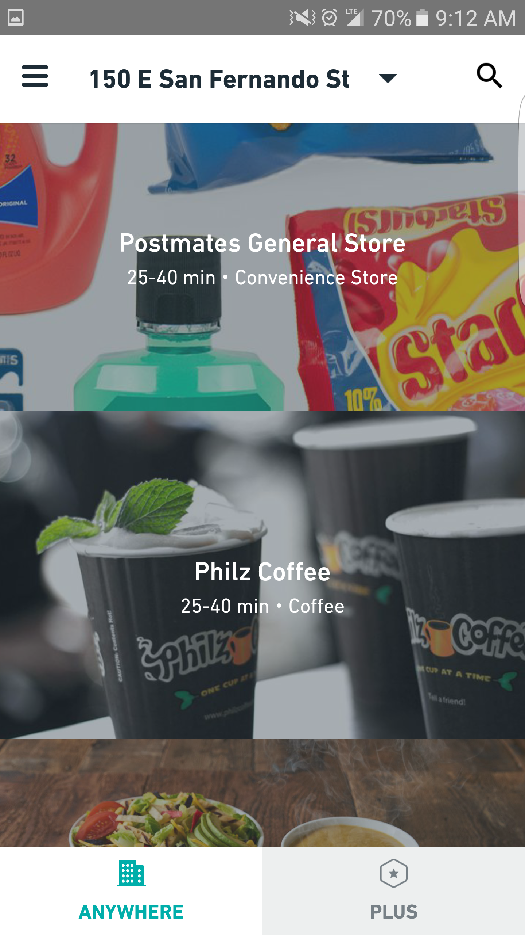
Postmates Application

Slide 4
Test Plan
Objective: Mobile Test automation of Postmates Android application
Features to be tested:
UI Elements (Buttons, Menu Items)
Sign In Functionality
Search Functionality
Promo code feature
Strategy used:
Testing conducted using Appium, an open-source, cross platform tool which uses Postmates apk to test.
Code is written and run in Eclipse IDE with the help of Android emulators and real devices.
Android ADT is installed in the system.
Finally TestNG is used for automation testing.

Slide 5
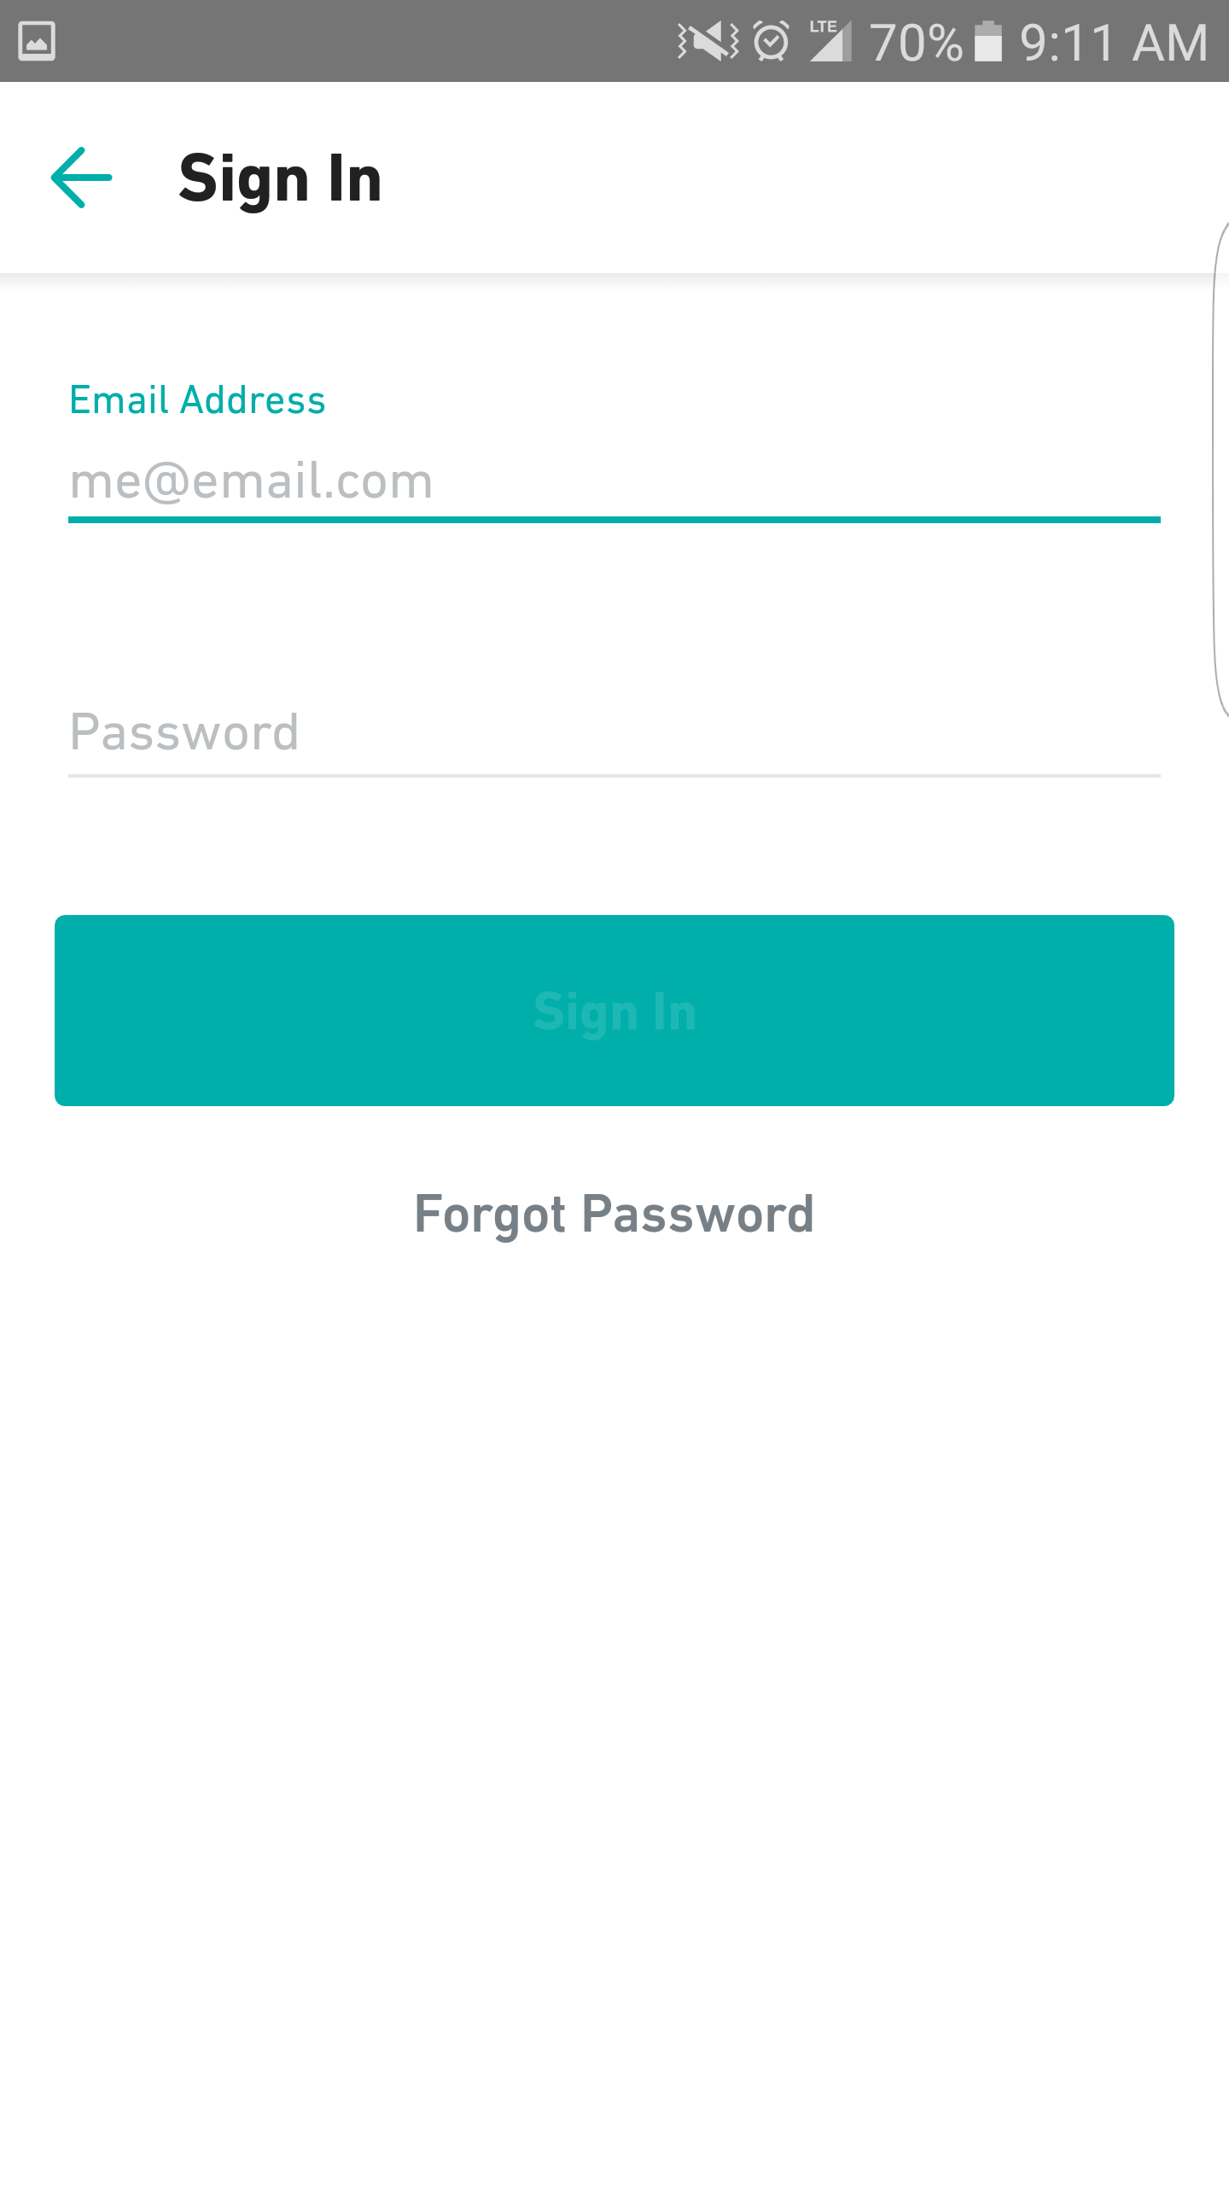
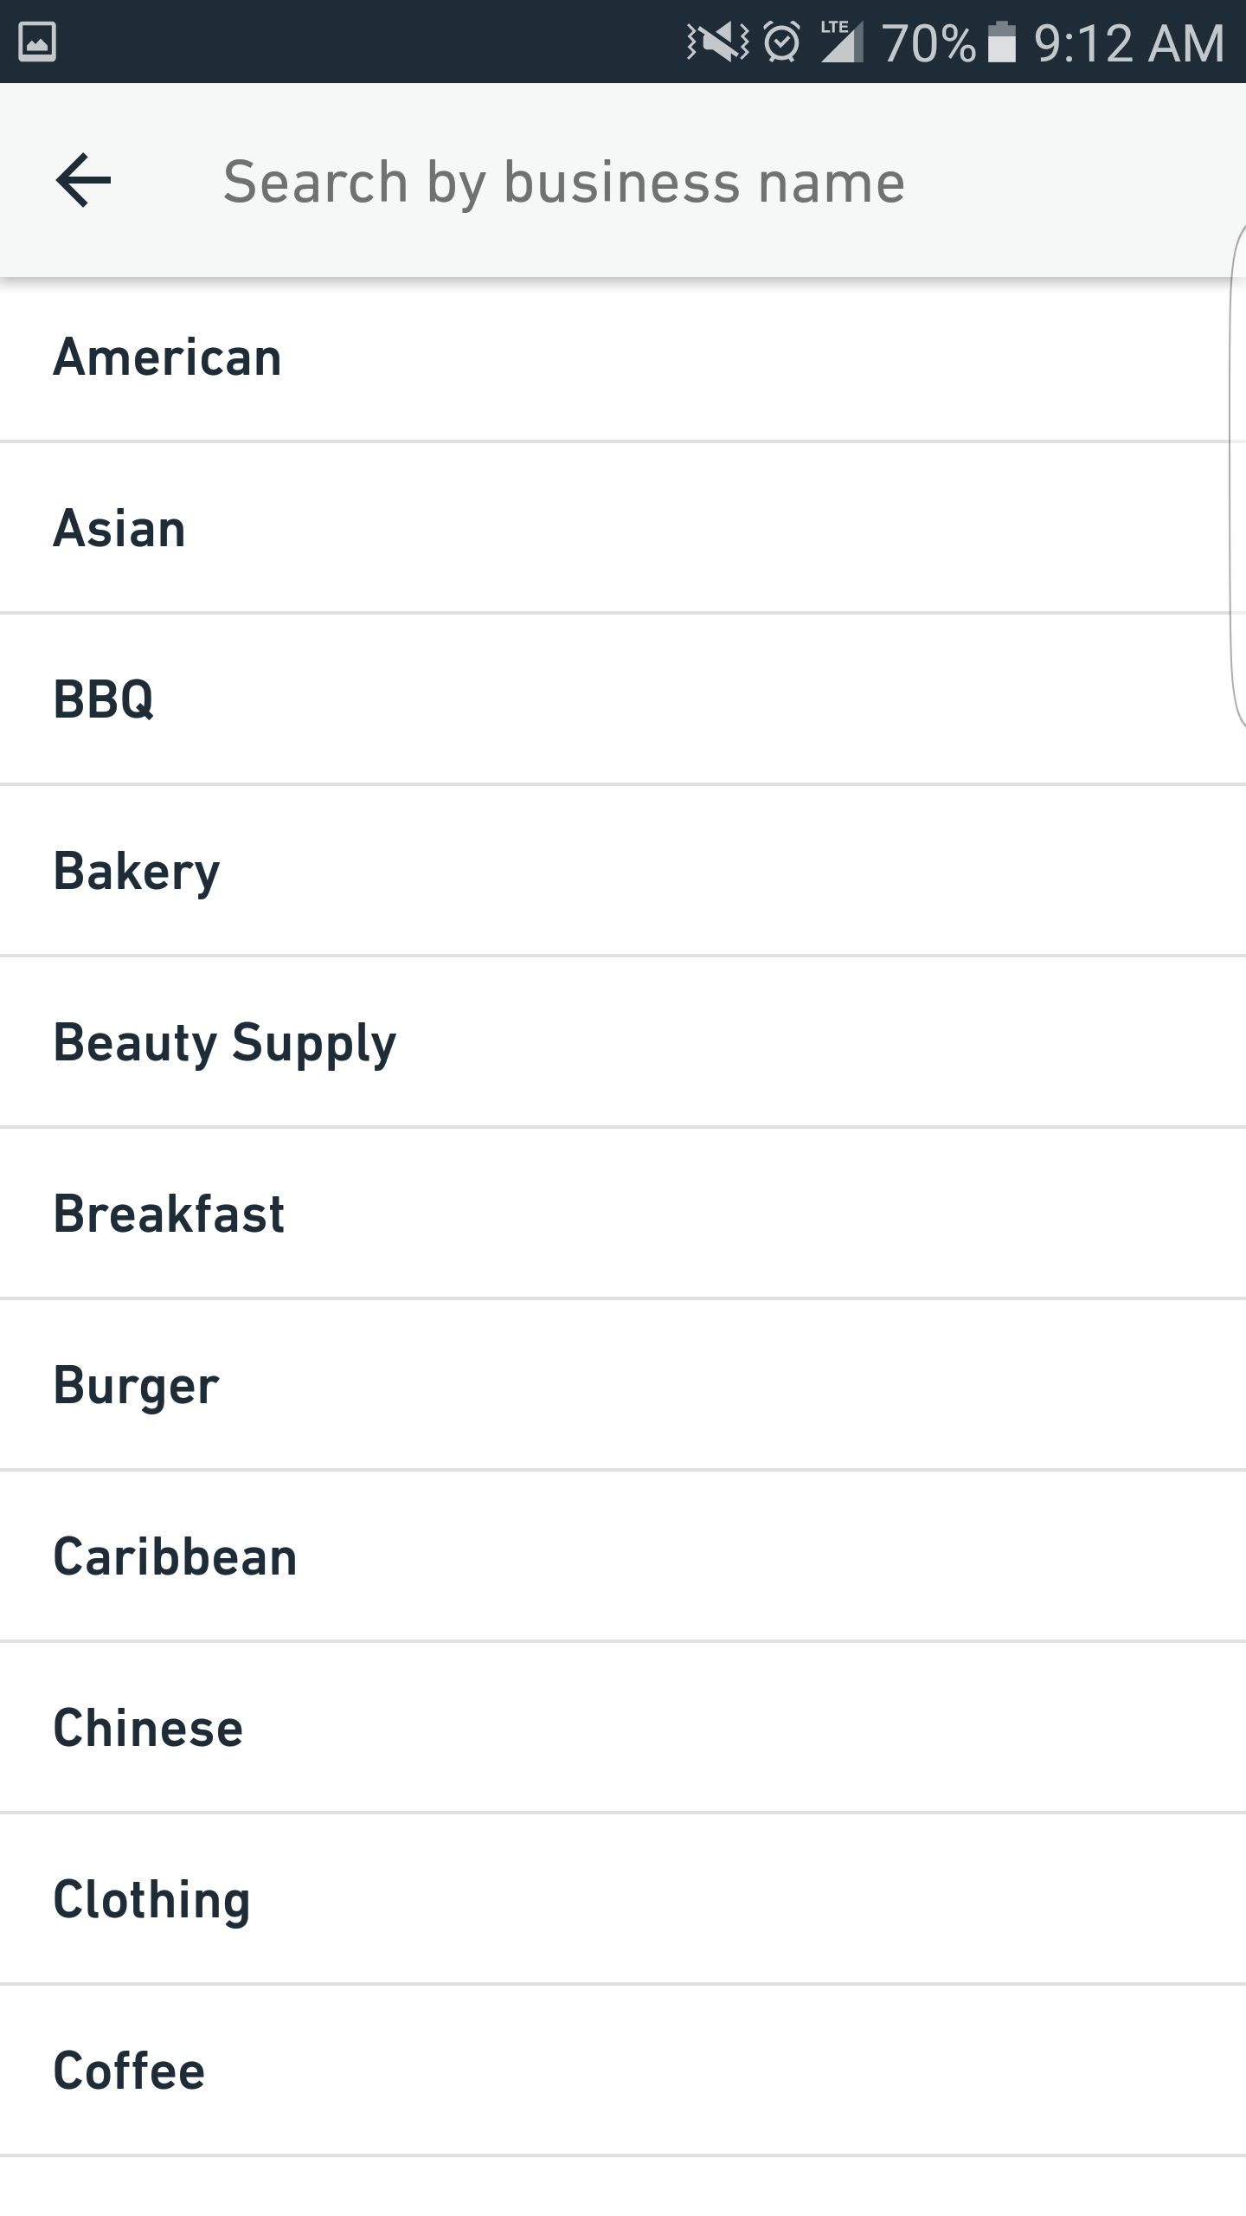
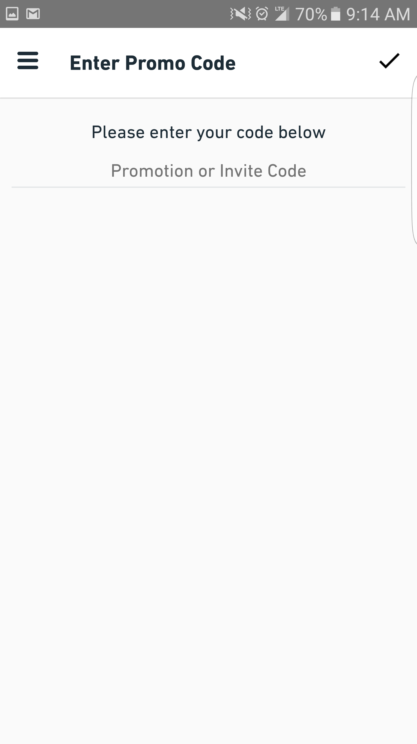
Features to be tested

Slide 6
Tool Selection
Appium: a cross-browser mobile automation tool for easy mobile application regression testing
Why appium?
Open Source and cross- platform(code reuse)
Supports multiple programming languages and platforms
Support for continuous integration
Runs through server without manipulating app
Backend Selenium support
Runs on emulators and real devices

Slide 7
Other Tooling Solutions
The tooling solutions used for the mobile test automation are:
Selenium Web Driver – To write automation scripts
Java SE – To run Java programs
Android SDK – To support appium server
Eclipse IDE – IDE for coding
TestNG – To run tests
Android AVD(Emulator) – For viewing script output
Real android devices – for viewing script outputs

Slide 8
Test Case(Feature) Demos

Slide 9
Test Report
All the test cases were successful.
The application showed good responsiveness.
All the tested features are working according to expectation.
Suggestions:
To improve the navigation schema and add "enter" button in the application rather than taking input from keyboard.
To avoid showing unavailable options in search results.

Slide 10
Conclusion and challenges
Conclusion:
Have been able to test all test cases designed successfully.
The Project helped understand mobile test automation better with hands on experience in Appium, Selenium WebDriver, TestNG, Android Studio and Android AVD.
Challenges:
Although setting up robotium as a test automation tool was an easier task, understanding the test script flow in the tool was difficult.
The tool had issues with test playback which added to the above problem.
So to overcome the drawbacks of the same, test automation tool was changed to Appium which seemed easier to use and understand.
In our research we found that it was a good tool for native apps but testing third apps was difficult.
Robotium uses source code, hence asks for apk signatures, where as appium doesn’t.
Robotium is not a freeware.

